Slide 1


MITSUBISHI
ISD AUTOMATATION
PROCESS

Slide 2
DESCRIPTION
HO will finalize the yearly budget.
Salary will be a uniform basis on City type T1, T2, and T3 (above minimum wages).
The basis of the Budget branch-wise headcount will be finalized.
Thrivera will organize interviews for vacant counters.
All the On boarding has to be done within 48 hours of joining.
Thrivera will make sure all the queries related to the application will be resolved within 30 min Other queries will be solved in 2 hours.
All the Attendance will be captured through the application, Geo fenced/IMEI function enable.)
Attendance calculation will be approved through the web portal (0% manual interference)
Incentives will be calculated calculate through the portal. The basis of the given target and achievement.
System generated invoice will be shared with HR within the same day of approval.
Notes:
<a href="https://storyset.com/business">Business illustrations by Storyset</a>

Slide 3
Current Vs. New Process
Current Process
New Process
1. HO shares the vacant counter details with Thrivera through mail.
2. Thrivera SPOC person connects with the Sales Executive and schedules the interviews.
3. Sales team shared the Requisition form with HO, and HO shares the same with the Thrivera SPOC person
4. Thrivera Team collects the required KYC documents on-board the candidate.
1. Option will be available on the HO Dashboard to add a new counter/Vacant counter.
2. Thrivera SPOC person will connect with the sales team and relevant profiles will be shared through the portal.
3. Sales Team will have the provision to approve the candidate through the portal, post his approval request will be sent through the system to HO(with mail notification).
4. We have already digitized the on boarding process.

Slide 4
5. Thrivera Team tracked attendance manually and shared the attendance sheet with the Sales team for the salary process.
6. After Confirmation from the respective Branch manager. Thrivera Team takes approval from HO.
7. With approval from HO, salaries are processed to ISDs.
5. ISDs will have a mobile application where they can mark their attendance daily,
6. ISDs can only punch their attendance from the respective counter as the application is geo-fence and can not allow marking attendance outside the outlet. Hence no need to verify at the month's end.
7. Same process.

Slide 5
UNIFORM SALARY SALAB
Uniformed Salary slab will be decided for all the branches.
Salary will be based on City category Tier 1, Tier 2, and Tier 3
Special approval can be given on the basis of Candidate qualification.
a. Fresher
b. 1+ experience in customer durable
c. 3+ experience in customer durable
Tier 1
Tier 3
Tier 2
Notes:
<a href="https://storyset.com/business">Business illustrations by Storyset</a>

Slide 6




HIRING STATUS
Pending
Request
CV Shared
With Client
Scheduled
Interview
On boarding
in-process
Onboard
Client
Confirmation
Notes:
<a href="https://storyset.com/business">Business illustrations by Storyset</a>

Slide 7
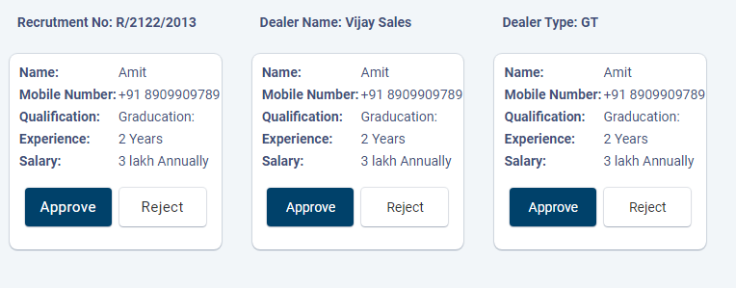
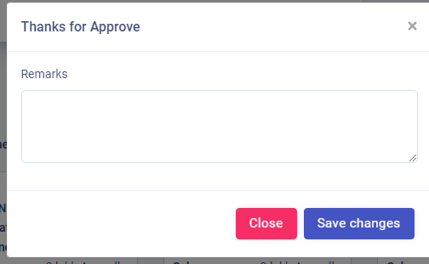
RECRUITMENT APPROVAL
Notes:
<a href="https://storyset.com/work">Work illustrations by Storyset</a>
Photo by Rachael Ren on Unsplash

Slide 8
ONBORDING
Thrivera will share onboarding link to candidate
Candidate will accept the offer & upload KYC documents
Thrivera team will verify the data
Salary structure will finalized from the compliance
Employee code will generate
ISD will receive the joining latter on his mail
Notes:
<a href="https://storyset.com/online">Online illustrations by Storyset</a>

Slide 9
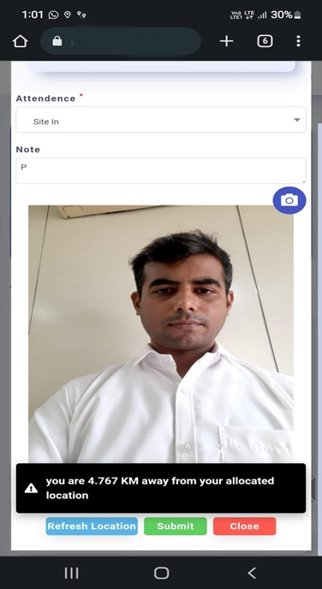
MONTHLY ATTENDANCE PROCESS
ISD can mark his attendance from the assigned Dealer location only. we have enabled geo location.
ISD has to take his picture in front of the product display area.
For the week off geolocation is disabled.
If attendance is not marked till the defined time, the application will notify the respective manager. And also notification will be sent to ISD mobile device.
ISD can mark 1 week off in 6 days gap.
TLs will be tagged with the respective branch office, Every morning they have to punch the site-in from the branch office.
Notes:
<a href="https://storyset.com/online">Online illustrations by Storyset</a>
<a href="https://storyset.com/user">User illustrations by Storyset</a>
<a href="https://storyset.com/people">People illustrations by Storyset</a>

Slide 10
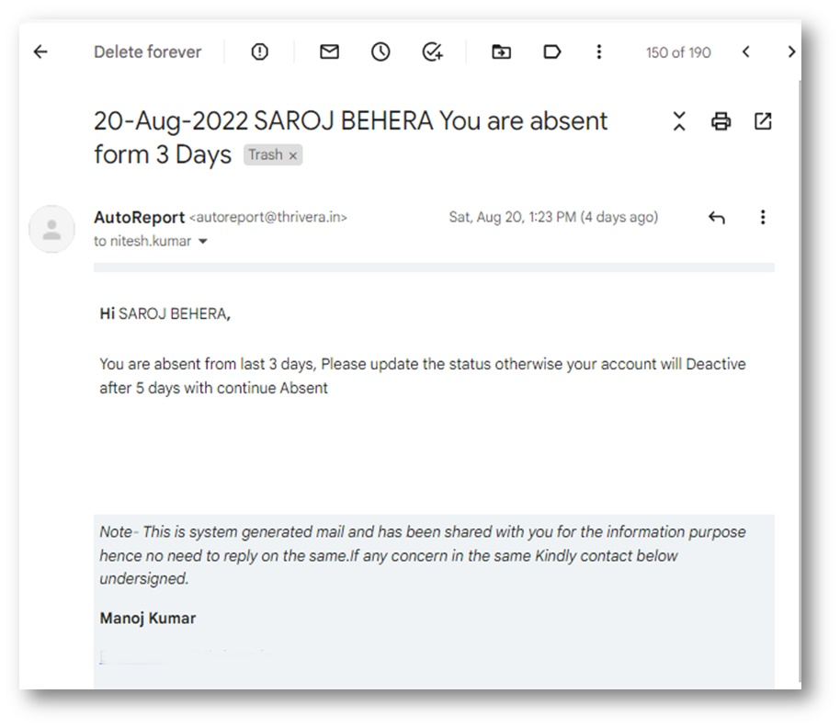
ABSENT RULES
If ISD is continuously absent for 3 days then a show-cause notice will be sent through email to ISD.
After 7 consecutive absences ISD will not be able to mark his attendance or any entry likes sales, RFC, or competition. ISD will be made inactive.
A list of ISDs who are absent for 3/5 days will be sent to the respective TL and BM through the auto mailer
BM/HO Approval will be required to re-activate the ISD in the system.
Notes:
<a href="https://storyset.com/education">Education illustrations by Storyset</a>
https://unsplash.com/photos/b6njEJXi9zE

Slide 11

ATTENDANCE REGULARISATION
All attendance regularization will be made only via the application.
An email notification will send to the respective approver and requester.
ISD and TL Must request attendance regularization for correction of their attendance.
TL can approve attendance regularization requests for his team.
For TL Branch manager will have a provision to approve/reject the request.
ISD/TL Can apply for RFC within 7 days. Beyond one week RFC will not be allowed.
Notes:
<a href="https://storyset.com/people">People illustrations by Storyset</a>
<a href="https://storyset.com/people">People illustrations by Storyset</a>

Slide 12
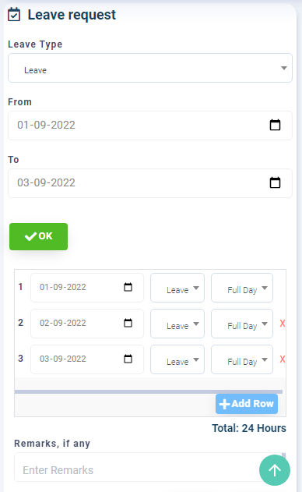
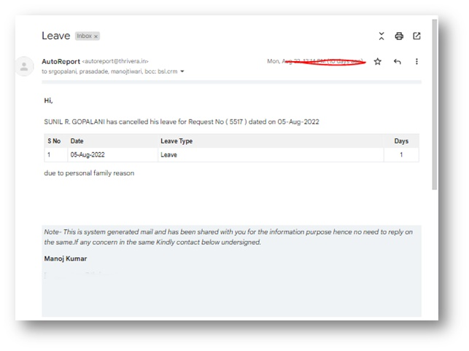
LEAVE APPROVAL
ISD can request 1 paid leave ( PL ) in a month on the portal, More than 1 leave will be considered as Leave without pay ( LWP ).
If the Leave balance is not available, ISD can not apply for leave.
ISD Leave request will be sent to the respective ASM through the mail. If ASM will not respond to the request it will be auto-approved after 48hour.
The system will maintain the leave balances of all ISDs.

Slide 13
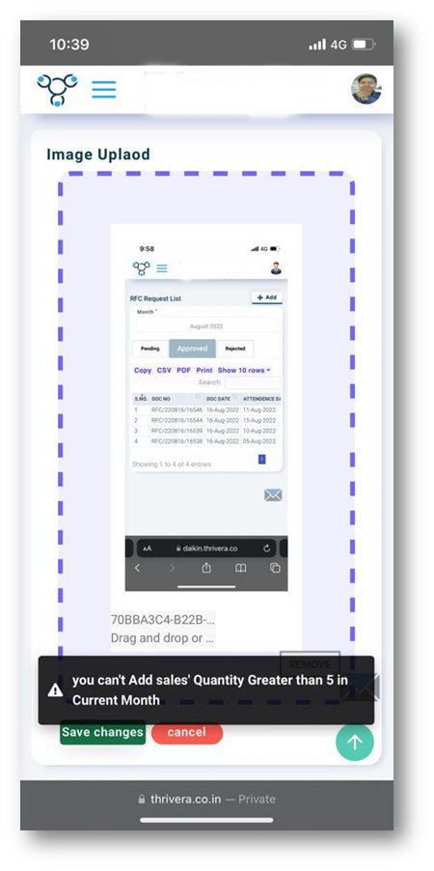
SALE ENTRY ON APP
ISDs have to punch all the sales in the application.
Only the current month's sale can be entered on the app. Back-month sale entry is not allowed.
To Prevent institutional sales entry. The application will not accept more than 5 units from The same customer(to be verified through Mobil number)
Customer data is mandatory to upload.
Model number, category, and quantity should be correct as per the invoice.
Sale can not be added without marking the attendance
On the competition entry Brand, Price, quantity, category, sub category and model is required

Slide 14
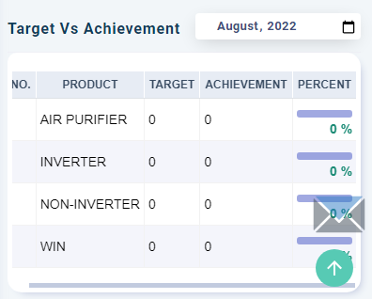
TARGET VS ACHIEVEMENT
Targets are mandatory for all the working ISDs
New joining requests will not be entertained without the targets.
ISDs Incentive will be calculated basis of app data, Only approved sales will be considered for incentives.
ISDs can view the achievement on the application
Product wise target will be visible on ISD mobile screens. i.e. Inverter, Non-inverter, Window, APU

Slide 15
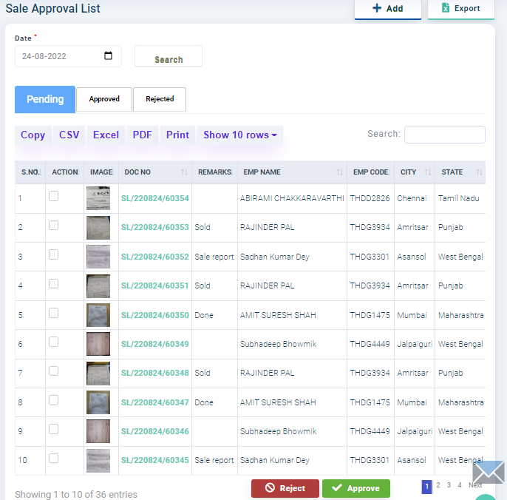
SALE VALIDATION
TL has the provision to verify the sale made by ISD.
Approved sale will be consider for incentive and achievements.
Tl has prevision to verify past month sales as well.
All sales must be verified for processing the incentive.
ISD can upload sale for current month only . System does not allow to upload past month sale.
Rejected sales will be shown on rejected tab. ISD can reload the genuine sales.

Slide 16
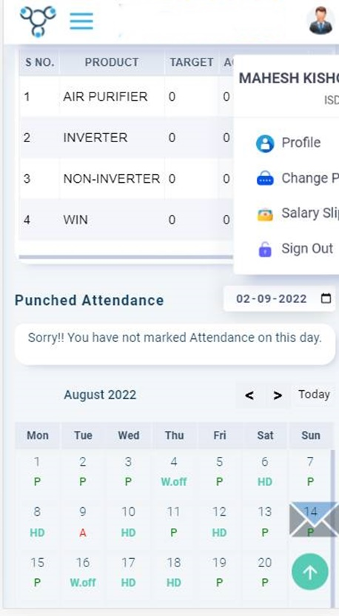
PRODUCT INFORMATION
ISDs can view all the information related to their Salary calculation, PF number UAN number, etc. on the application.
ISD can download and share the E-catalogue from the application.
Incentive calculation, sales details, monthly attendance calendar, All the details are available on the application.

Slide 17
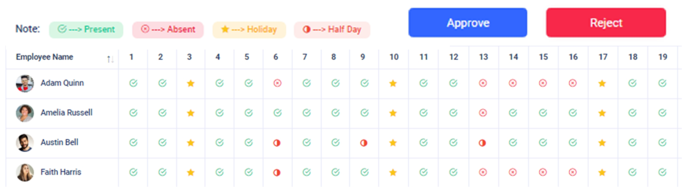
ATTENDANCE APPROVAL
The respective Area Executive/ Marketing team can view and validate the monthly attendance of his team.
The concern Manager has to approve/reject the leave and RFC application before giving the final approval
Salaries will be processed as per the approved attendance without any manual interference.

Slide 18





QUICK REPORTS ON DASHBOARD
Budget
SALES
PRODUCTIVITY
ON BOARDING
ATTENDANCE
TOP SELLING
BRAND

Slide 19

ONLINE TRANNING/ MEETING
To minimize the alteration regular communication is very much required.
In process of same Thrivera team will organize regular team meeting branch wise or split the number if branch number are high.
Purpose of the meet is to make ISD aware on company policy and update regarding the application.
Time to time we will organise quiz competition, Basis on product knowledge/ industry knowledge and some GK question.
ISD can ask their queries and Thrivera team will try to provide on-spot resolution to the issues/queries.
Mitsubishi Marketing team will be requested to be the part of the meet.
Meeting will be organized at between 11am to 12pm so it will not effect the productivity of the day.

Slide 20
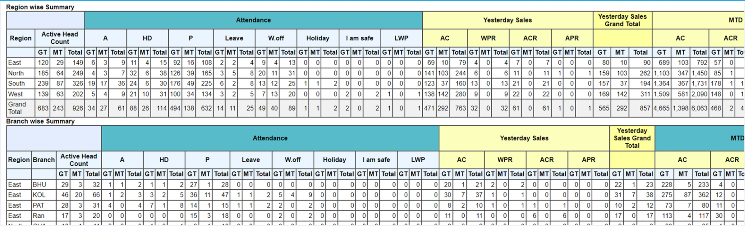
Daily sales and productivity Auto-Report
System will send automated daily mail with monthly attendance summary count, yesterday sale count with categorization, MTD sales count with categorization and region wise and

Slide 21

THANK YOU
Notes:
<a href="https://storyset.com/city">City illustrations by Storyset</a>

